Slide 1




Better Together: Navigating Universal FAFSA Through Strategic State Partnerships
2026 College Affordability Summit
Midwestern Higher Education Compact
June 11, 2026

Slide 2

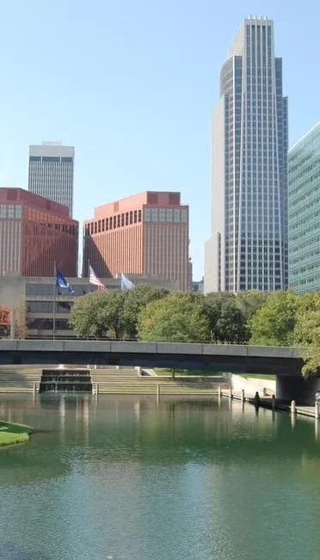
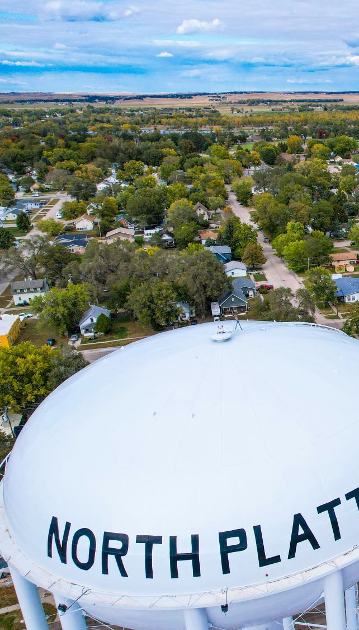


Slide 3

Nebraska background…
Nebraska background…

Slide 4
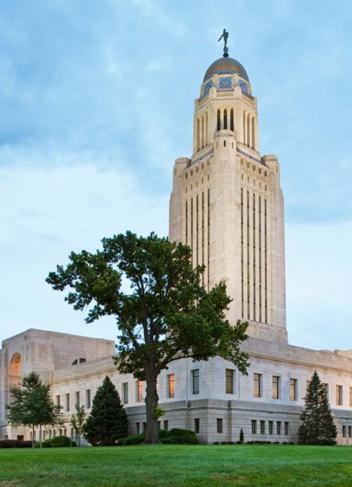
Legislative History
Nebraska has a unicameral government
  49 senators
  Can serve two four-year terms

Slide 5
Legislative History
LB1089 passed
FAFSA required
The governor vetoed
LB705 passed
Approved by the governor
Implementation began with the class of 2025
2020
2023
2025

Slide 6



Nebraska FAFSA Task Force
A Nebraska private foundation
School administrators
School counselors
College financial aid officers
Youth serving CBOs

Slide 7
Task Force Gap Analysis
Research conducted with school counselors and administrators to determine what was needed to support implementation.
Findings included:
  Resources to explain the law and WHY it is needed
  Deployment support
  Public awareness support

Slide 8
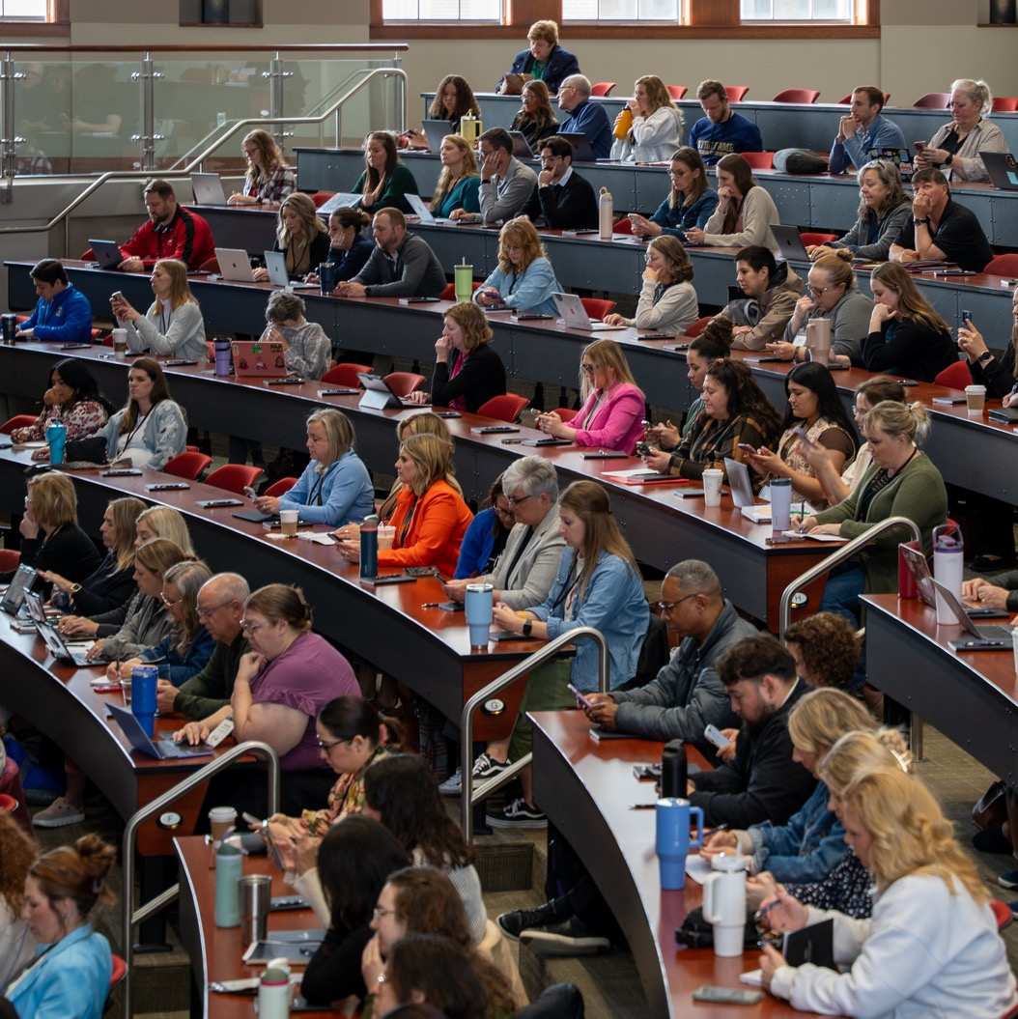
FAFSA Support
Based on findings, we developed and launched:
  FAFSA completion lesson plans
  A support website from the Nebraska Department of Education
  FAFSA completion sessions at the EducationQuest biennial Symposium

Slide 9


Slide 10
Nebraska FAFSA Completion

Slide 11
*As of May 26, 2026
Source: Nebraska Coordinating Commission for Postsecondary Education

Slide 12


Support Ahead

Slide 13
Key Takeaways
Relationships matter!
Focus on
strengths!
Communicate!

